Slide 1
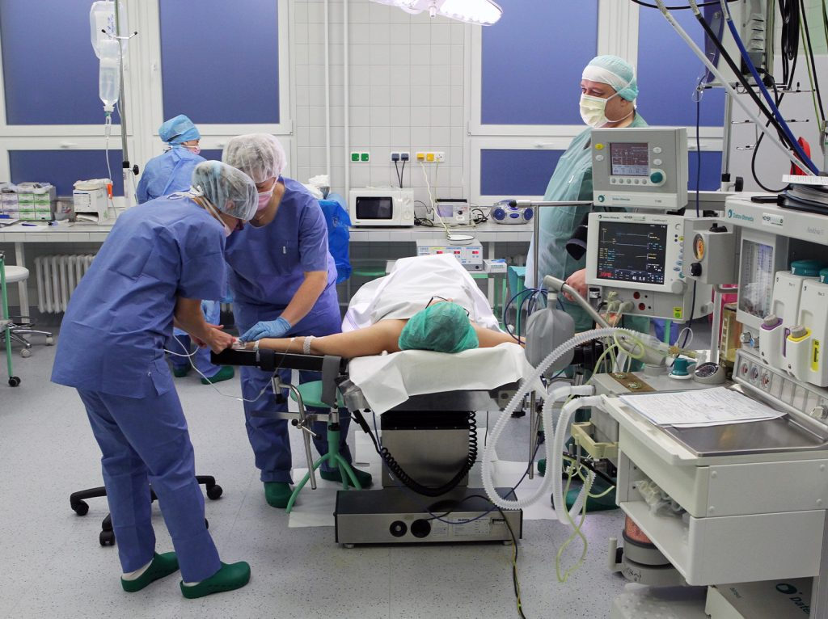
Komplikace císařského řezu
Petra Herboltová, GPO Nemocnice Jihlava
11. Jihlavská konference fetomaternální a perinatální medicíny: „Zdravý jedinec, zdravá společnost“
VŠPJ 20.6.2024 Jihlava

Slide 2
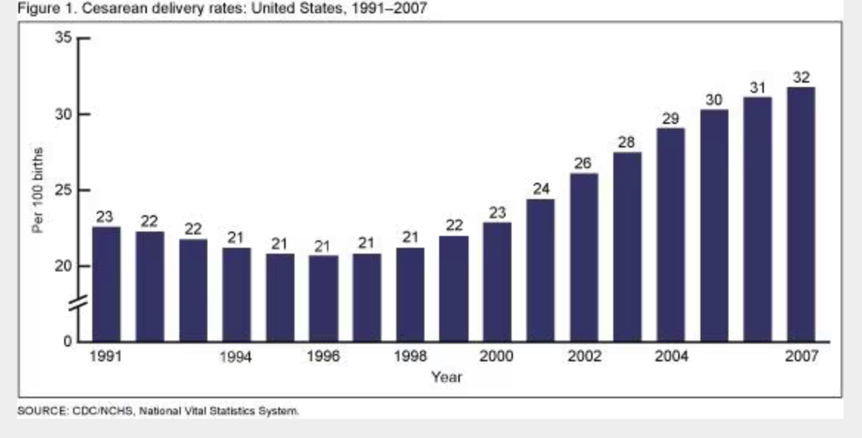
Operace – indikace, podmínky, následky, rizika, komplikace
WHO: Caesarean section rates have increased steadily worldwide over the last decades. This trend has not been accompanied by significant maternal or perinatal benefits. On the contrary, there is evidence that, beyond a certain threshold, increasing caesarean section rates may be associated with increased maternal and perinatal morbidity.

Slide 3
WHO 2018:
According to the latest data from 150 countries, currently 18.6% of all births occur by caesarean section, ranging from 1.4% to 56.4% (11). Latin America and the Caribbean currently have the highest caesarean section rates (40.5%), followed by North America (32.3%), Oceania (31.1%), Europe (25%), Asia (19.2%) and Africa (7.3%). Trend analysis based on data from 121 countries shows that between 1990 and 2014, the global average caesarean section rate almost tripled (from 6.7% to 19.1%) with an average annual rate of increase (AARI) of 4.4%. The largest absolute increases occurred in Latin America and the Caribbean (by 19.4 percentage points, from 22.8% to 42.2%), followed by Asia (by 15.1 points, from 4.4% to 19.5%), Oceania (by 14.1 points, from 18.5% to 32.6%), Europe (by 13.8 points, from 11.2% to 25%), North America (by 10 points, from 22.3% to 32.3%) and Africa (by 4.5 points, from 2.9% to 7.4%). This steady and unprecedented rise in the use of caesarean section in the last decades has resulted in global concern, debate and a call for action from the scientific, public health and medical communities, particularly in view of the 2015 World Health Organization (WHO) statement on caesarean section rates (12,13).
1.2 WHO statements on caesarean section rates
For nearly 30 years, the international health-care community has considered the ideal rate for caesarean section to be between 10% and 15%. This has been based on the following statement by a panel of reproductive health experts at a meeting organized by the World Health Organization in 1985, in Fortaleza, Brazil: “There is no justification for any region to have a rate higher than 10–15%” (14). The panel’s conclusion was drawn from a review of the limited data available at the time, mainly from northern European countries that demonstrated good maternal and perinatal outcomes with this rate of caesarean section.

Slide 4
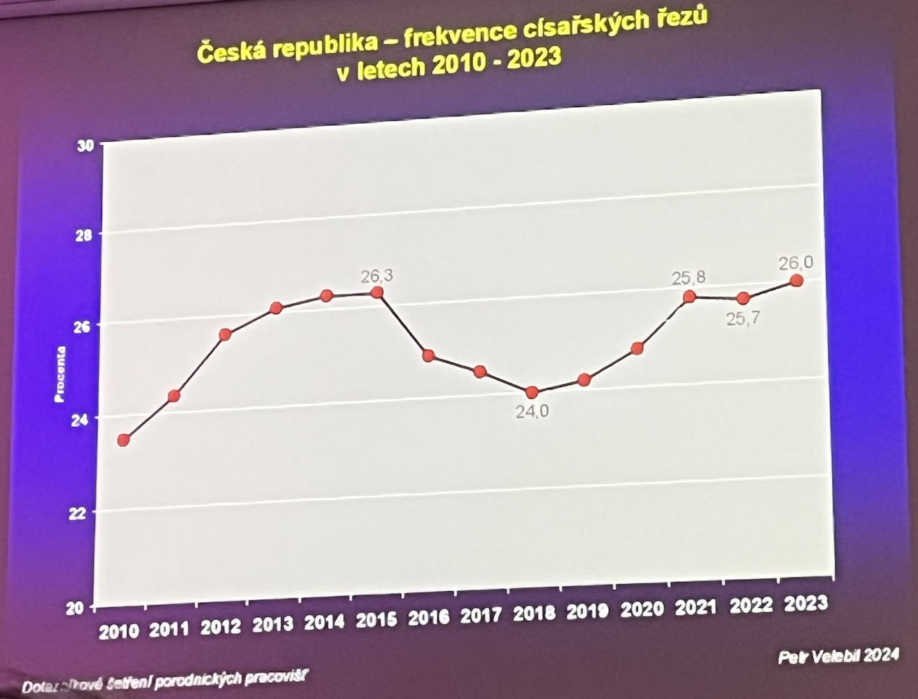
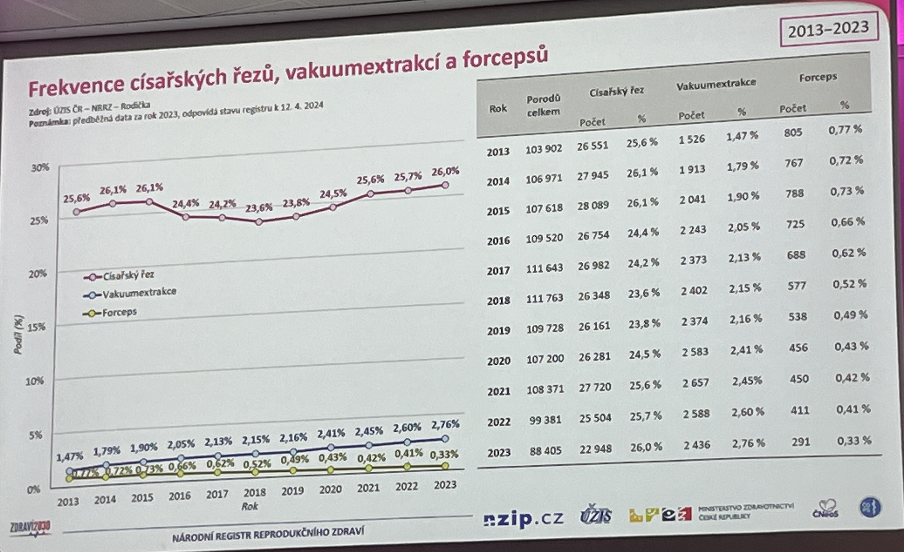
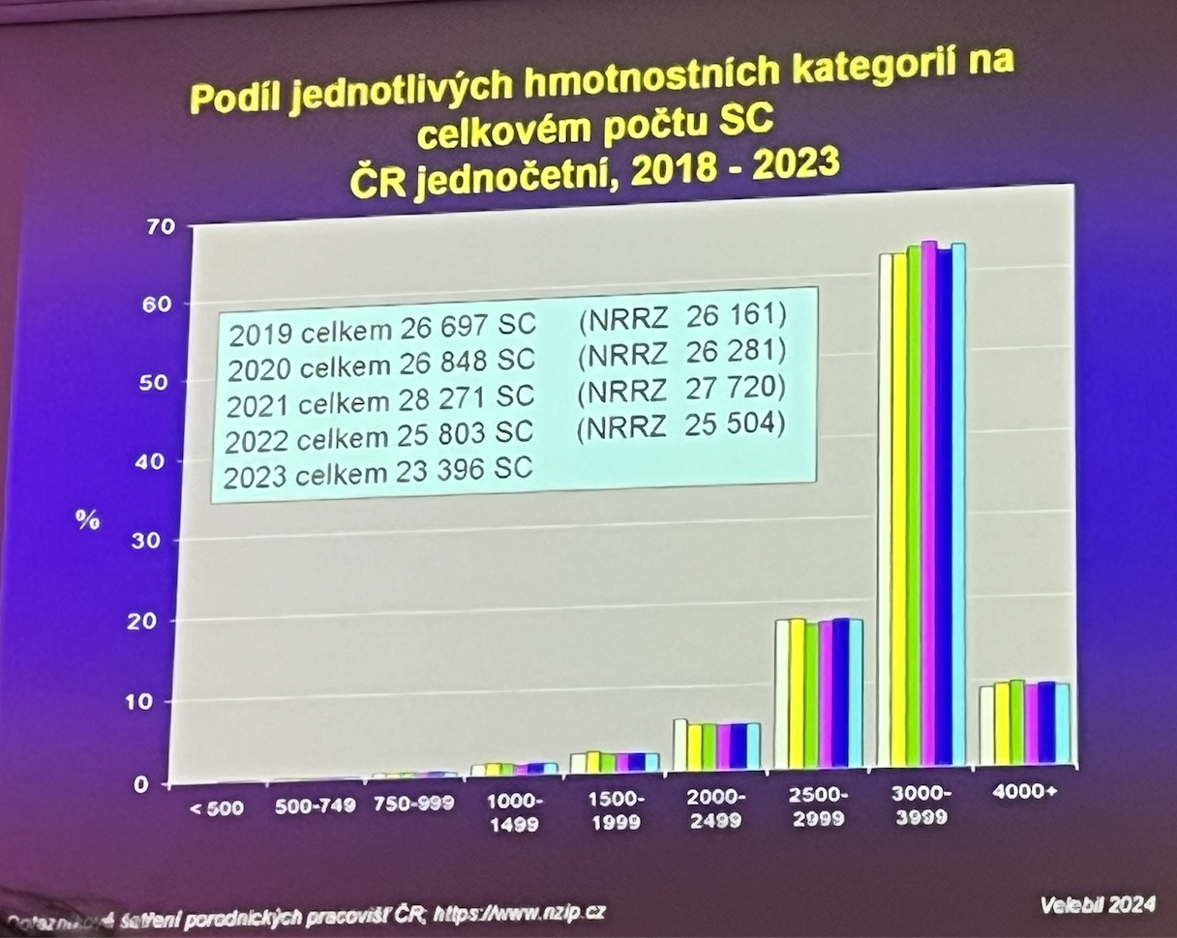
Nem. Jihlava 2023:
1235 … 314 SC
25,43%

Slide 5
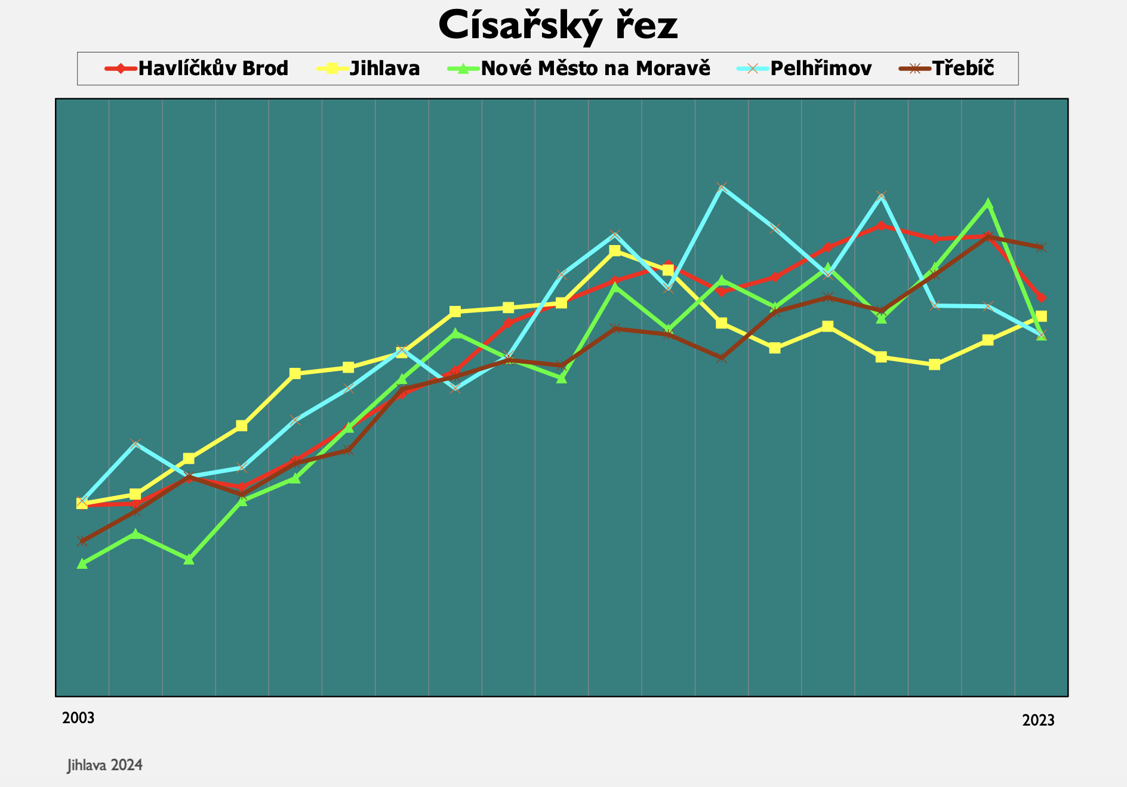
Vysočina 2023
Nem. Jihlava 2023:
1235 … 314 SC
25,43%
elektivní 159, akutní 155
KP 46, gemini 6, indukce + SC 12

Slide 6
„Jisté/pravděpodobné“ následky SC
Omezená mobilita, omezení péče o novorozence, omezení kontaktu s novorozencem, s rodinou
Opožděný začátek laktace? (první hodina)
Jizva 100 %
Kožní část – estetický efekt
Jizva na děloze – riziko
Risk of placenta previa 0.05% (CS) compared to 0.027% (vaginal delivery) (CS 2x)
Risk of placenta accreta from roughly 0.00029% to 0.0006% (CS 2x)
Risk of placental abruption 0.005% to 0.007% (CS 2x)
www.thevbaclink.com
Riziko ruptury děložní stěny, KZ, hypoxie/úmrtí plodu, HE
- riziko rpt dělohy během gravidity nebo porodu s děl. jizvou 0,15-2,3% (bez jizvy 0,035%)
- úspěch VBAC = 60-70%
Jistota: anestezie, analgesie, bolest

Slide 7
“Méně pravděpodobné“ následky SC
Akutní
Krevní ztráta
Poranění okolních orgánů
Anesteziologické komplikace
TEN, KV, embolie PV
Pobyt na JIP
Infekční komplikace
Pomalý nástup střevní peristaltiky
Úmrtí
Long term
Adheze v dutině břišní
Následky akutních komplikací
Endometriosa?
Kýla v jizvě
Změny menstruačního cyklu
Psychologické

Slide 8
Canada, 354 mother-child dyads between 2009 and 2013 from the Alberta Pregnancy Outcomes and Nutrition (APrON) study
PPD post partum depression
PTSD post-traumatic stress disorder
mothers who experienced an emergency or unplanned C-section had increased PTSD scores of nearly half a point (0.47) compared to mothers who underwent a planned C-section, even after adjustment. Overall, emergency C-section was indirectly associated with PPD symptoms, through PTSD symptoms.
Deprese, anxieta, smutek, vyčerpání, nespavost, naštvání www.thevbaclink.com

Slide 9
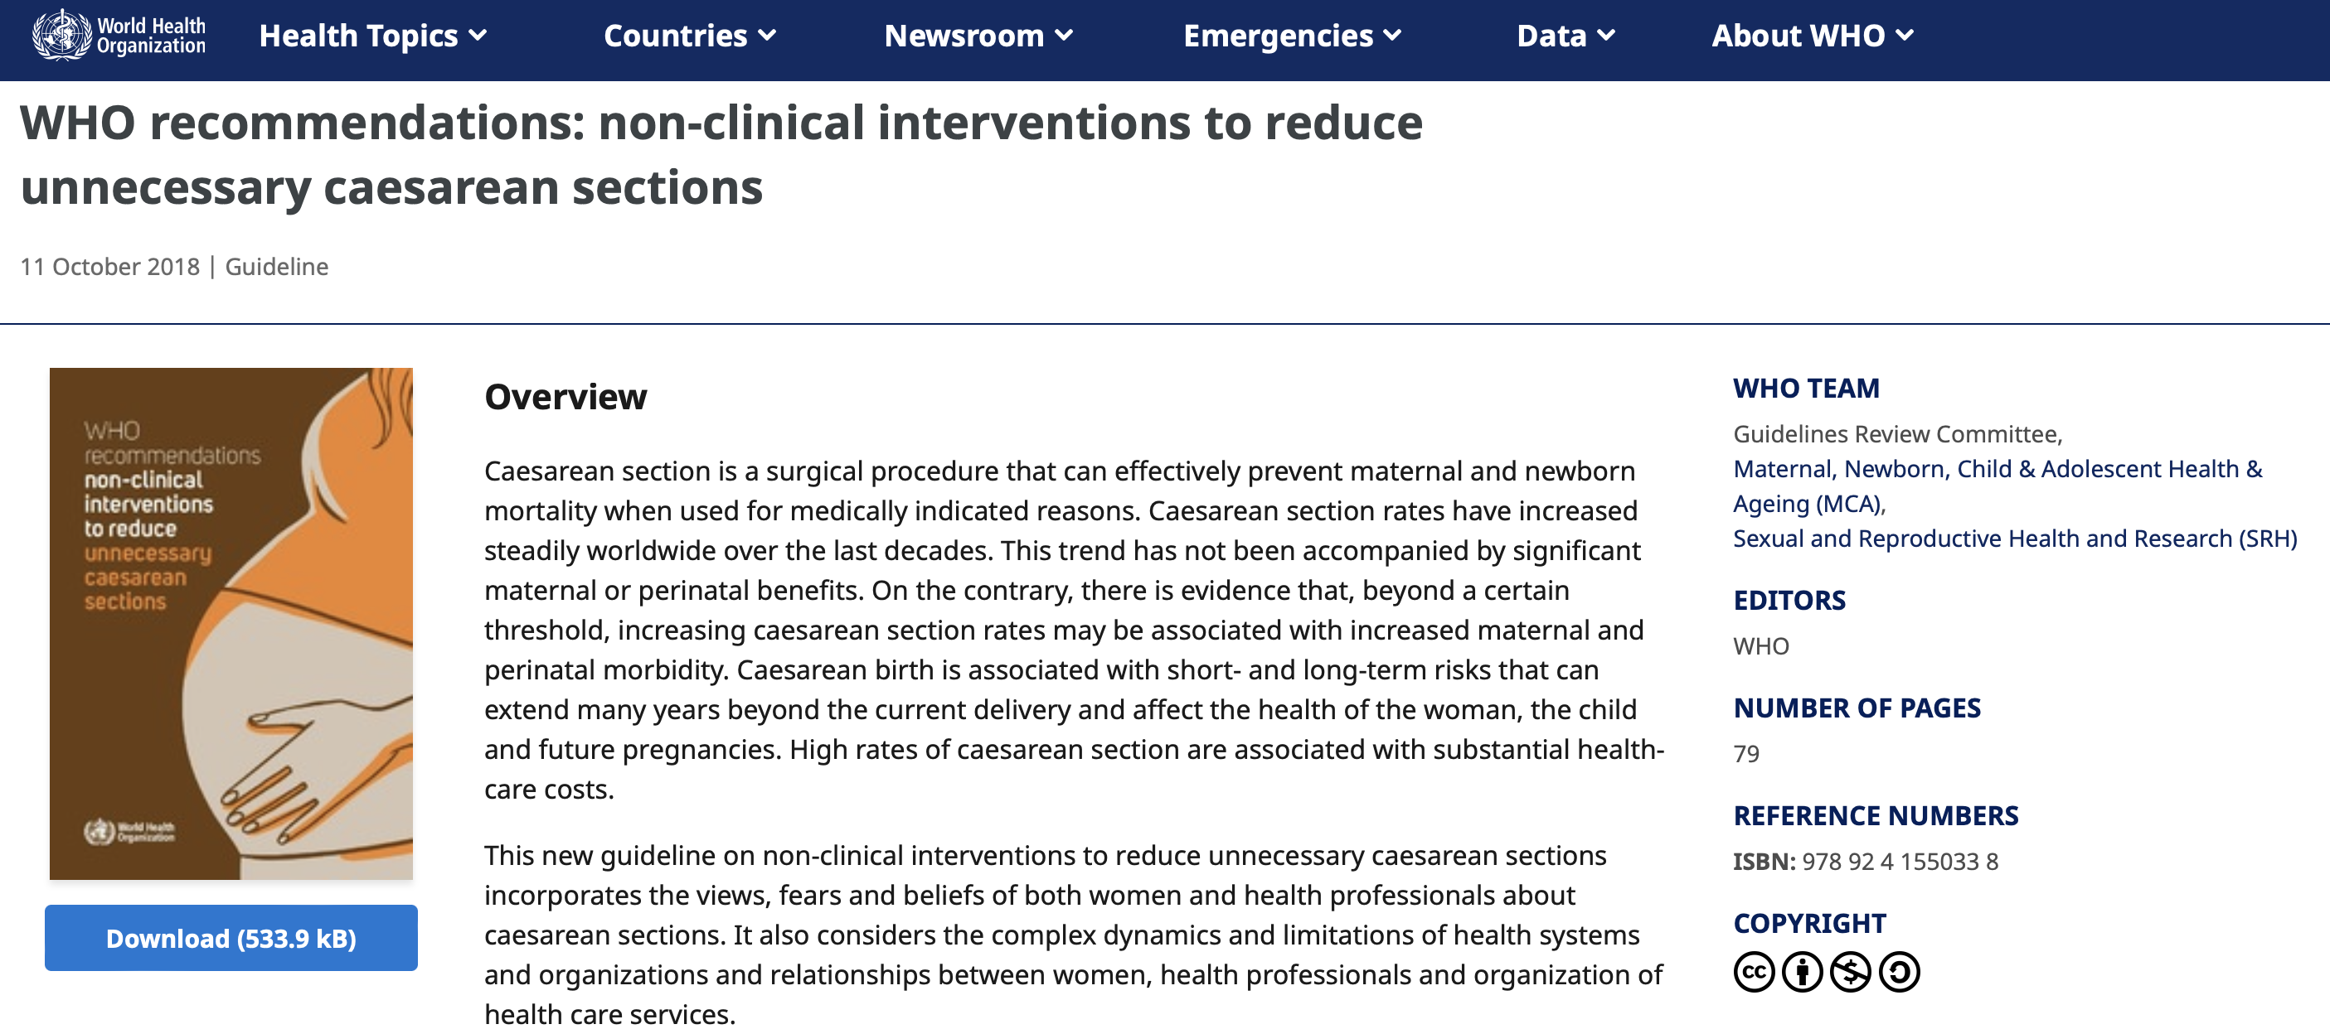
A. INTERVENTIONS TARGETED AT WOMEN (Childbirth training workshops, Nurse-led applied relaxation training programme, Psychosocial couple-based prevention programme, Psychoeducation)
B. INTERVENTIONS TARGETED AT HEALTH-CARE PROFESSIONALS
C. INTERVENTIONS TARGETED AT HEALTH ORGANIZATIONS, FACILITIES OR SYSTEMS

Slide 10
Pozitivní následky - benefity
Psychologické
Rodinné
Caesarean Delivery on Maternal Request (CDMR) – podmínky - The 2013 American College of Obstetricians and Gynecologists (ACOG) Committee on Obstetric Practice and 2006 National Institutes of Health (NIH) consensus committee, Cesarean Delivery Updated: Sep 06, 2023 Author: Hedwige Saint Louis, MD, MPH, FACOG; Chief Editor: Christine Isaacs, MD more...
Pánevní dno – prevence poranění
x dysfunkce pánevního dna, morfologické změny m.LA, inkontinence moči a stolice, sestup dělohy a poševních stěn, sexuální dysfunkce.
- věk prvního vag. porodu 35 let - informace rodičky o rizicích vag. porodu

Slide 11
Novorozenec
Iatrogenní poranění novorozence (chirurgické)
Pobyt NJIP
Delší hospitalizace, riziko rehospitalizace
Neonatal respiratory distress syndrome RDS
Long term – riziko obesity, riziko asthmatu, DM 1, alergie, snížená imunitní funkce, snížení kognitivních schopností do 8 let, zhoršení vazby matka-dítě, …?

Slide 12
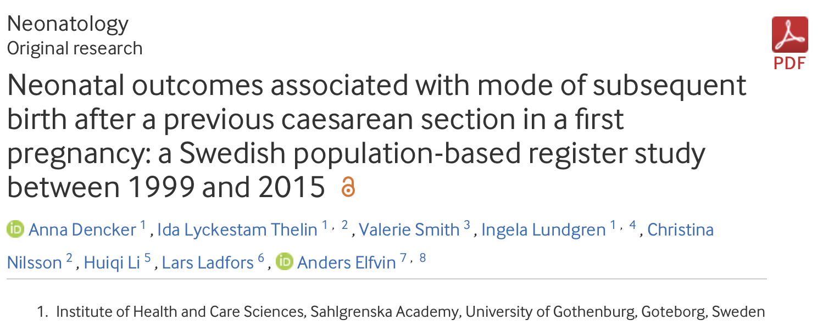
BMJ Paediatrics Open 2022;6:e001519. doi: 10.1136/bmjpo-2022-001519
National retrospective population-based register study. A cohort of 94 451 neonates who were born in Sweden between 1999 and 2015 as a second child to a mother who had her first birth by emergency or planned caesarean.
Caesarean section (CS) rates are rising in many countries.
Repeat planned CS is common after previous CS.
A planned vaginal birth after previous CS may result in an emergency CS and risk of worse neonatal outcomes.
Spontaneous vaginal birth after previous CS was related to lower risk of neonatal asphyxia and/or respiratory distress when compared with any other mode of birth.
Spontaneous vaginal birth after previous CS was related to a lower risk of neonatal hospital care when compared with instrumental vaginal or emergency CS birth.
Spontaneous vaginal birth after previous CS was related to a lower risk of neonatal death when compared with instrumental vaginal or emergency CS birth.
Vaginal birth may be recommended as a safe option after previous CS.

Slide 13
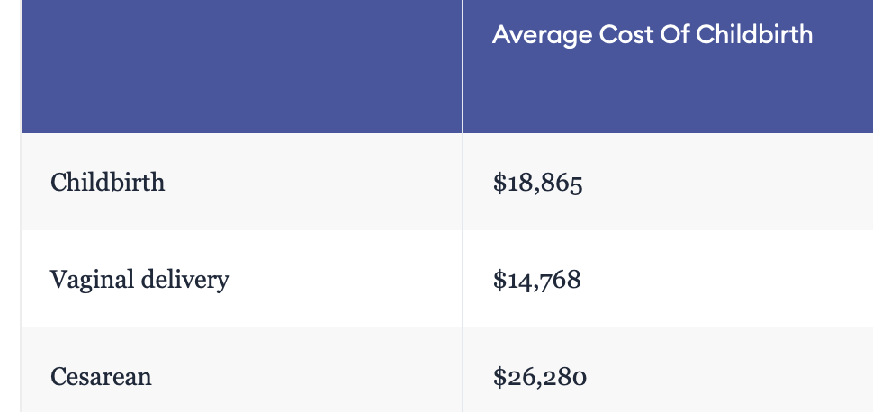
Ekonomika
USA – SC US$13,590.00 per event, vaginální porod US$9,131.00 (o 30% méně) 2013
Value-based care in obstetrics: comparison between vaginal birth and caesarean section
Romulo Negrini, Raquel Domingues da Silva Ferreira, and Daniela Zaros Guimarães, Brazil
BMC Pregnancy Childbirth. 2021; 21: 333.
Published online 2021 Apr 26. doi: 10.1186/s12884-021-03798-2
Truven Health Analytics . The cost of having a baby in the United States. 2013
For Medicaid, the average costs involved in cesarean delivery including prenatal care, childbirth, and postnatal care are US$13,590.00 per event. On the other hand, for vaginal deliveries this cost is about 30% lower, i.e., US$9,131.00
USA 2023: Here’s the average cost of delivery

Slide 14
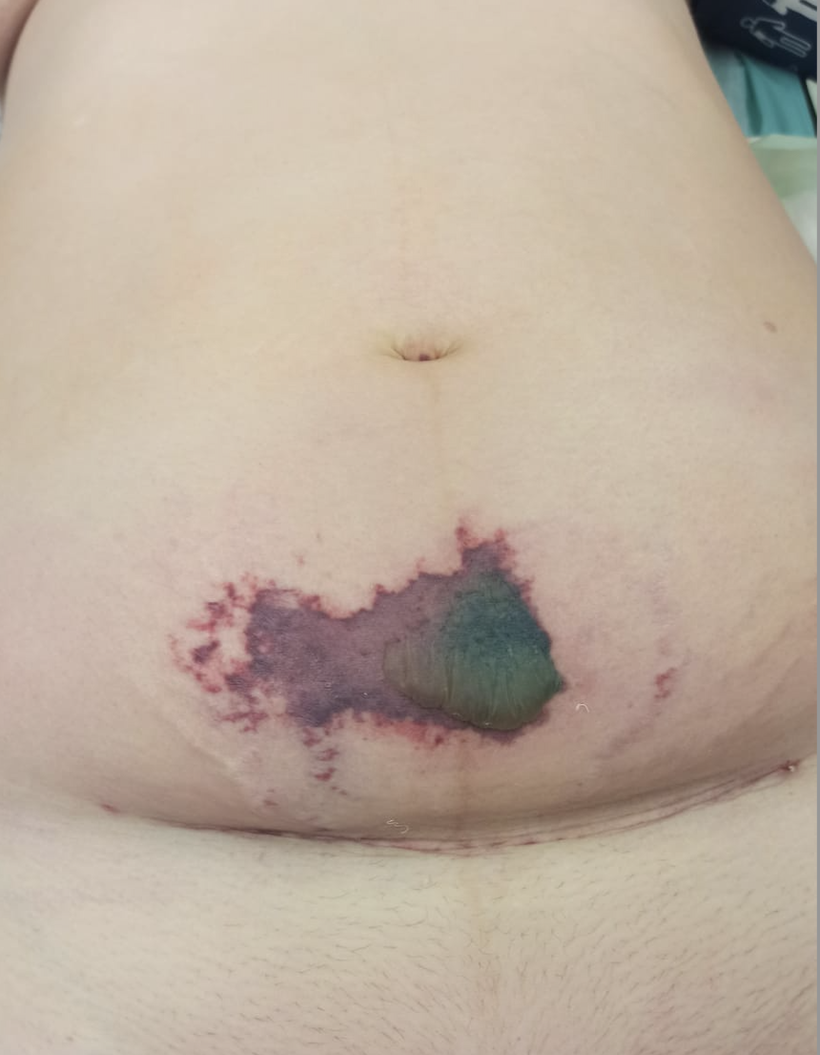
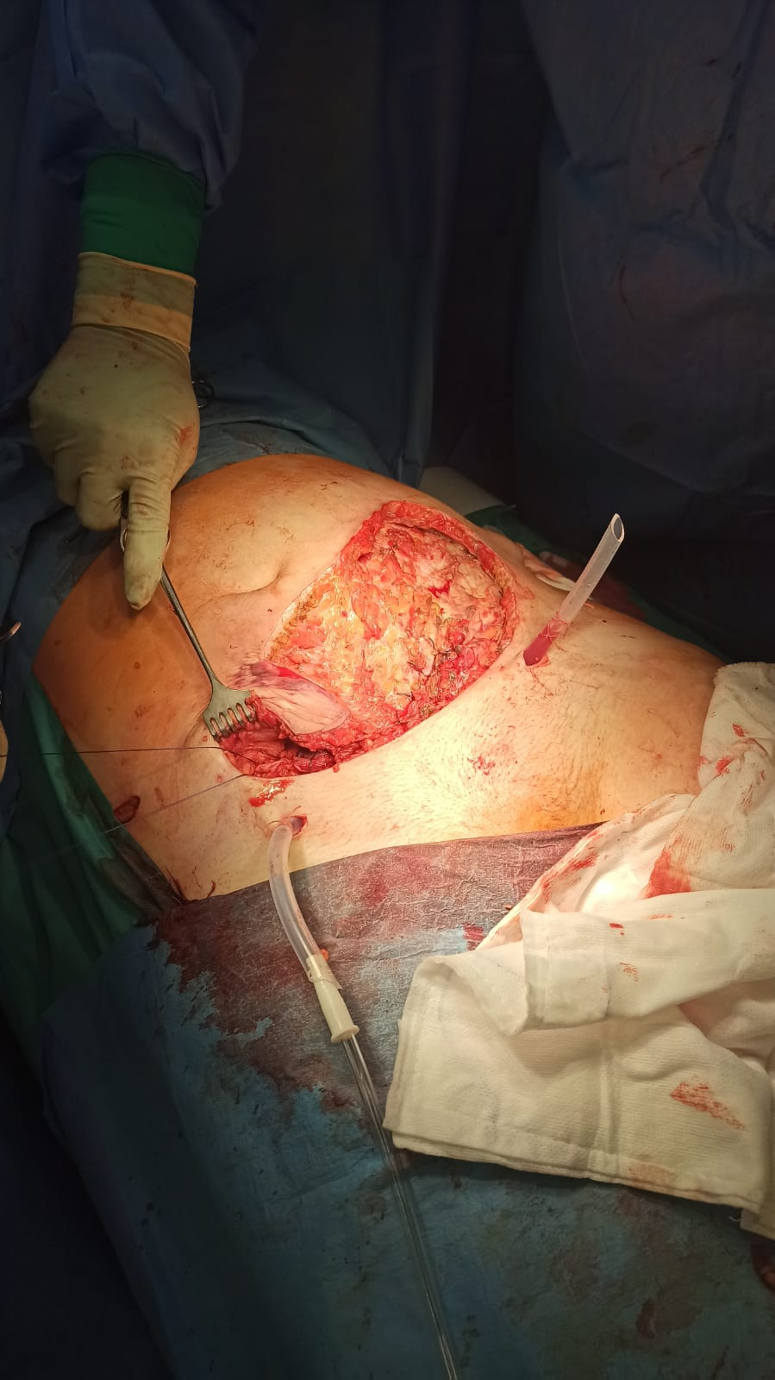
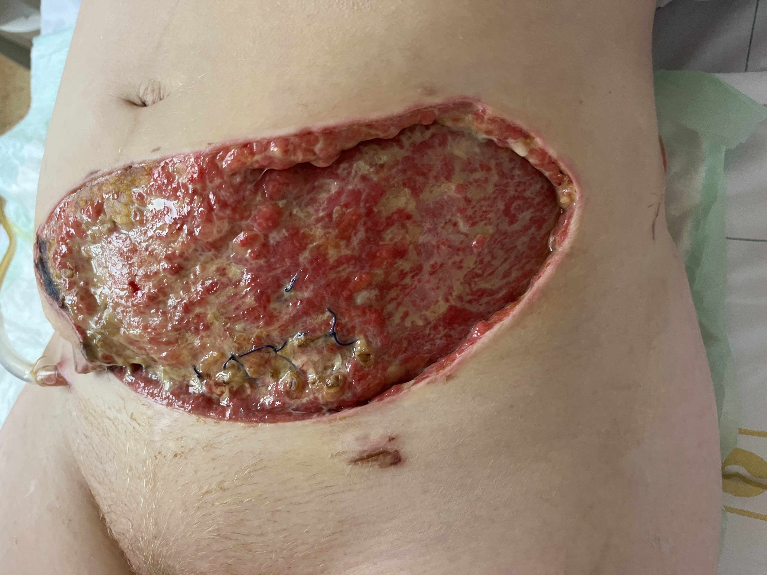
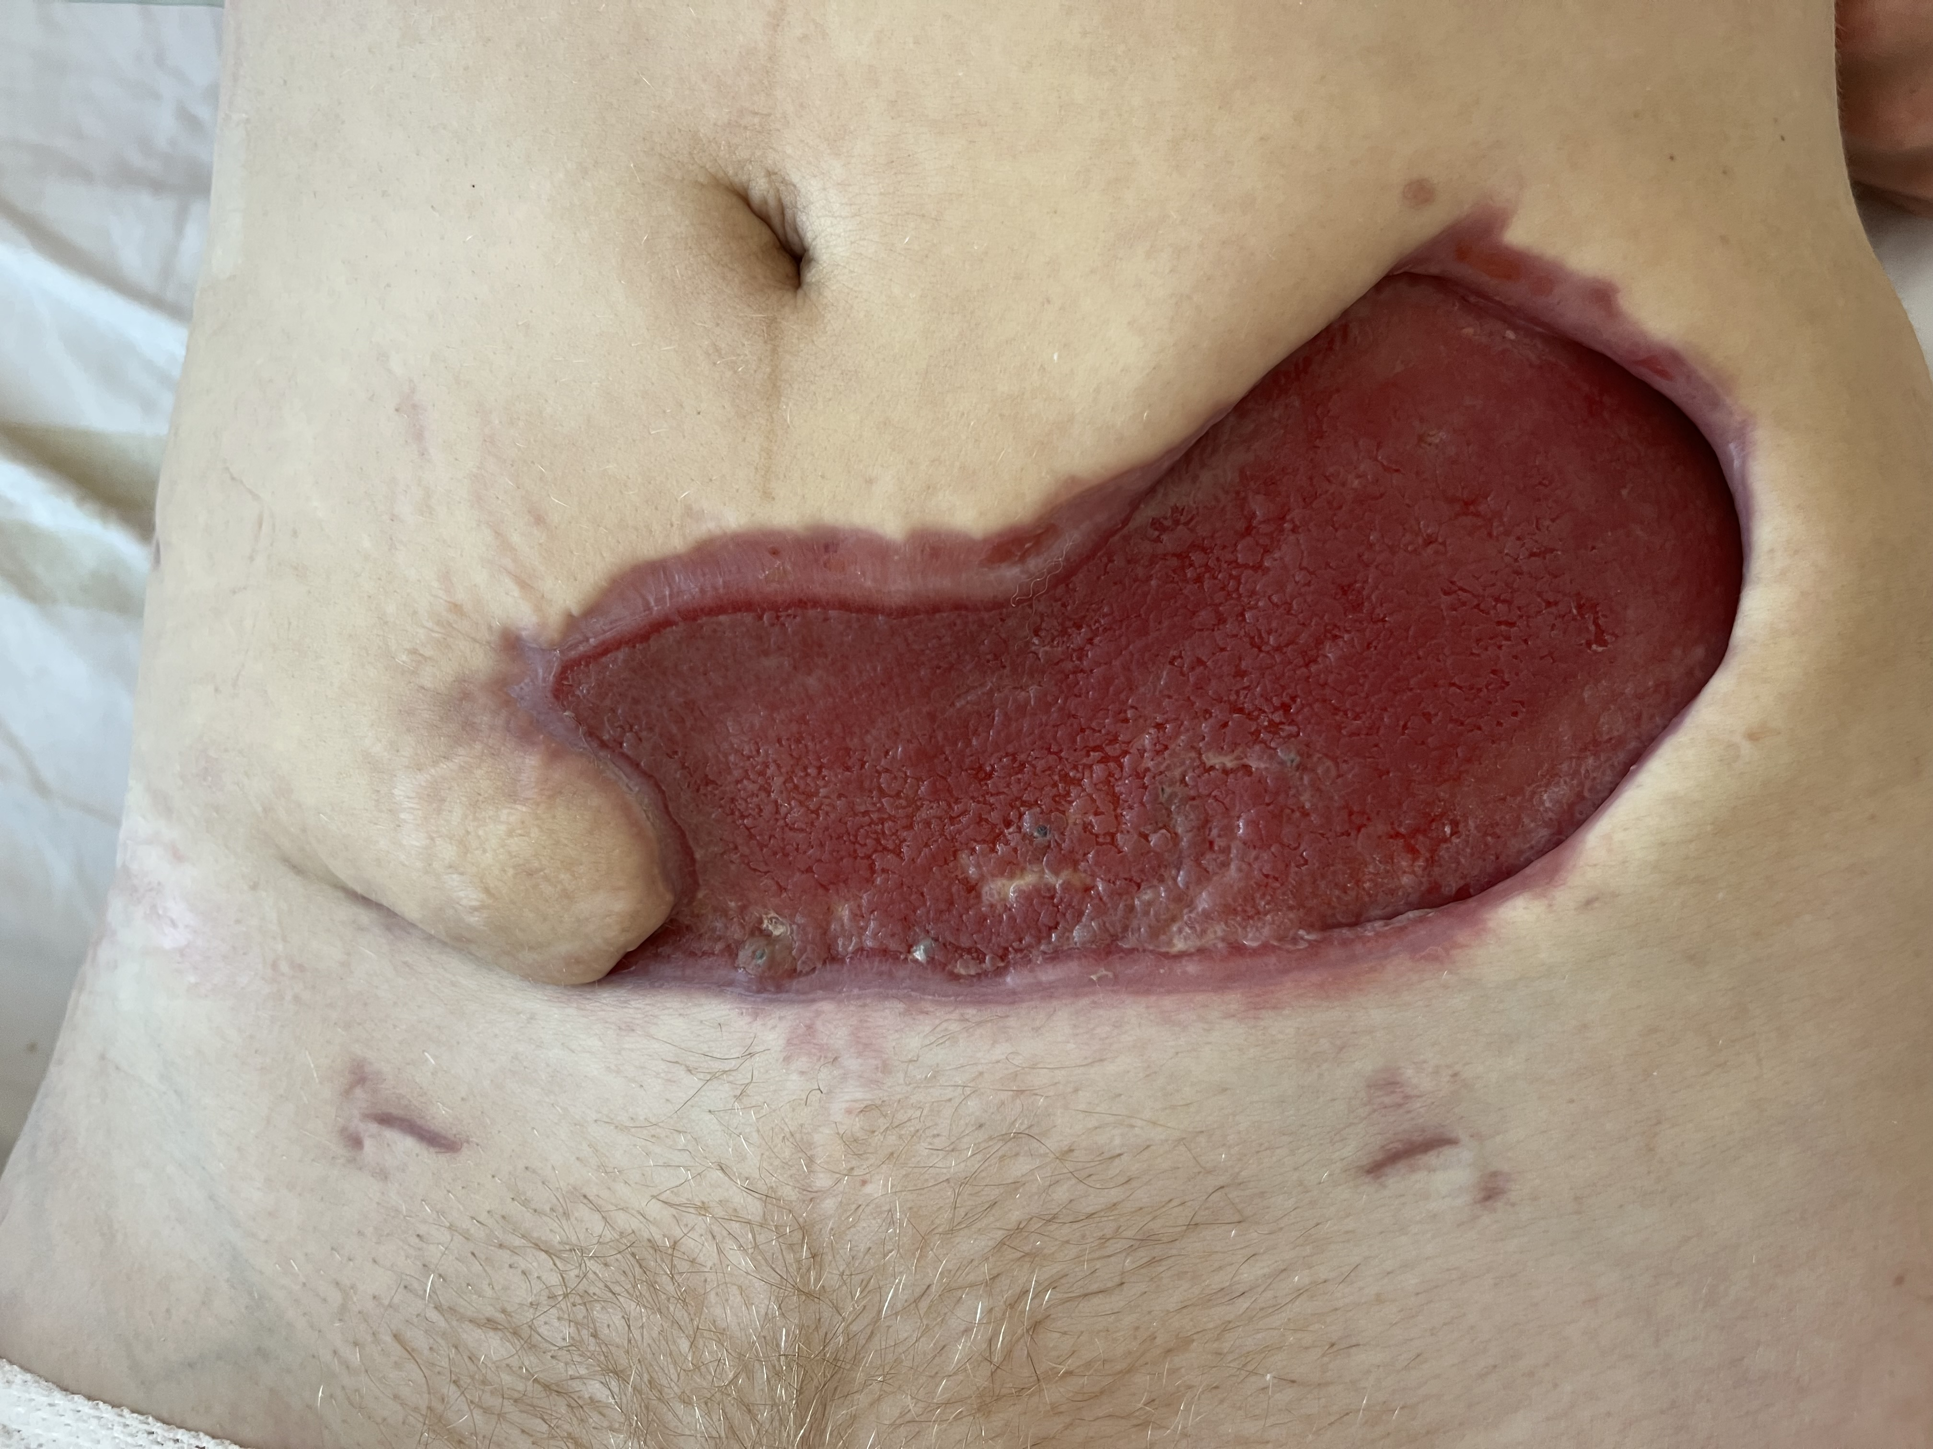
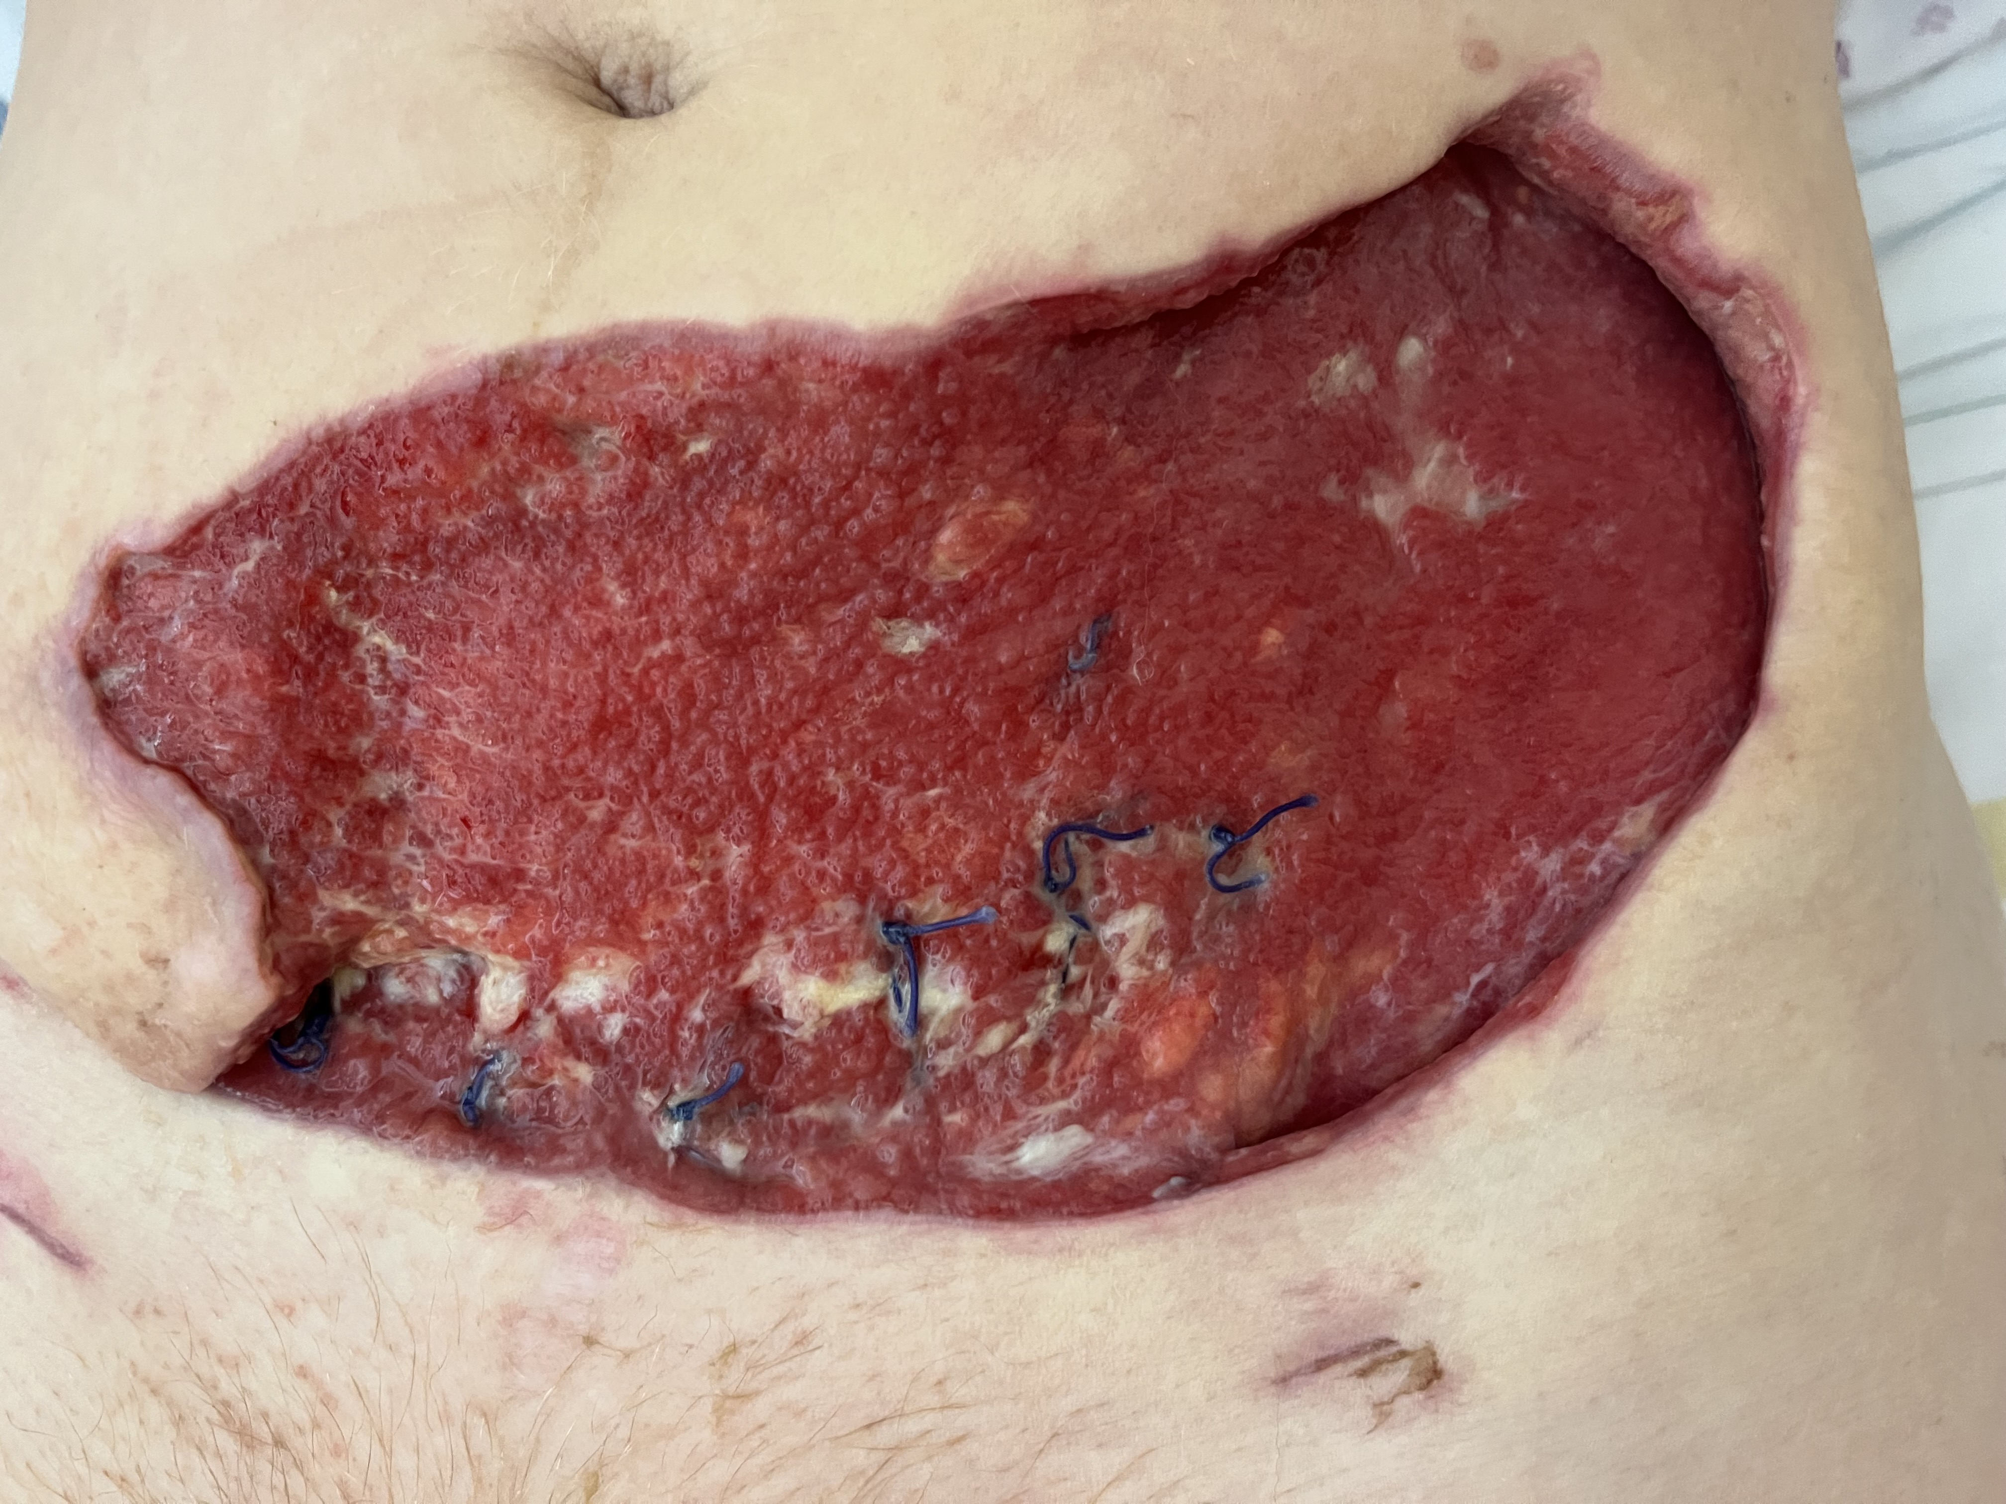
IIp, 26 let, FGR SC, 8.den
Anaerococcus tetradius (Peptostreptococcus)

Slide 15
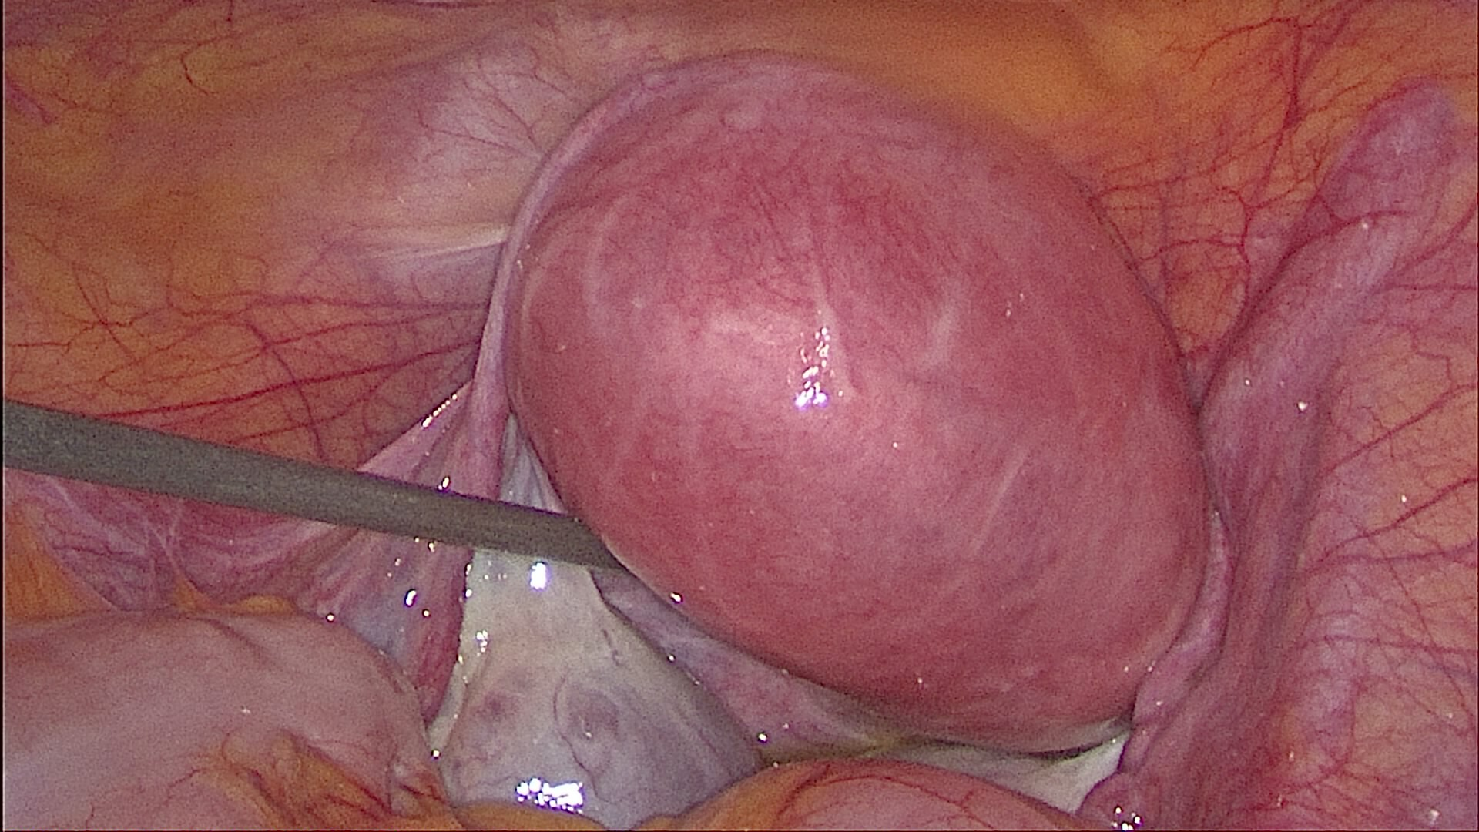
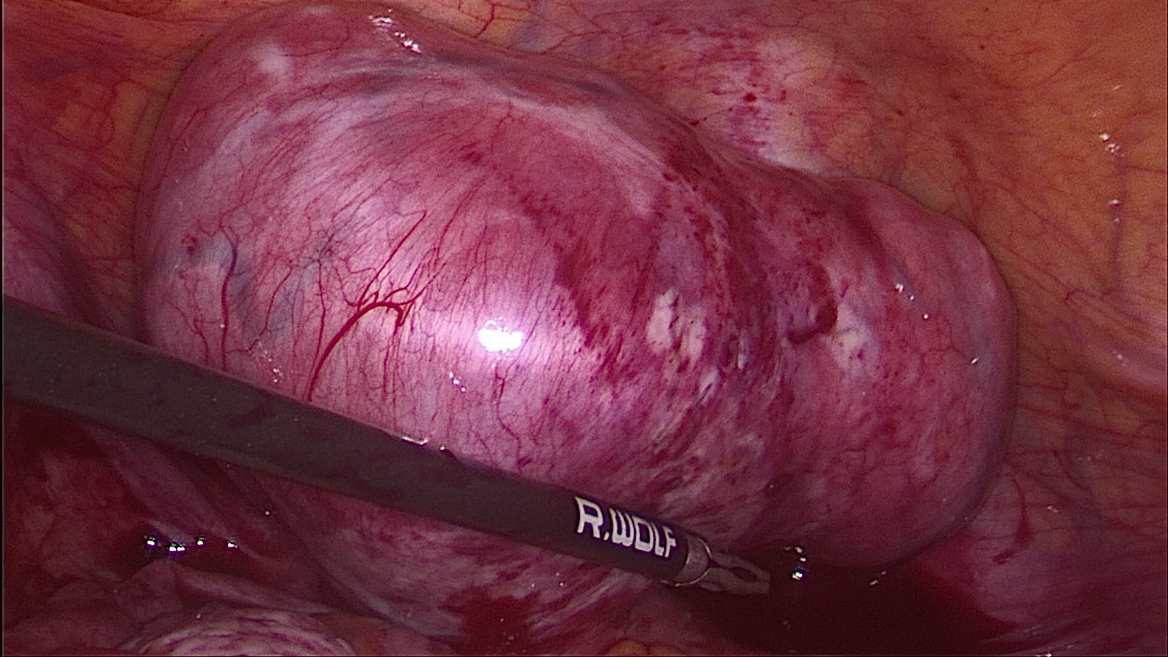
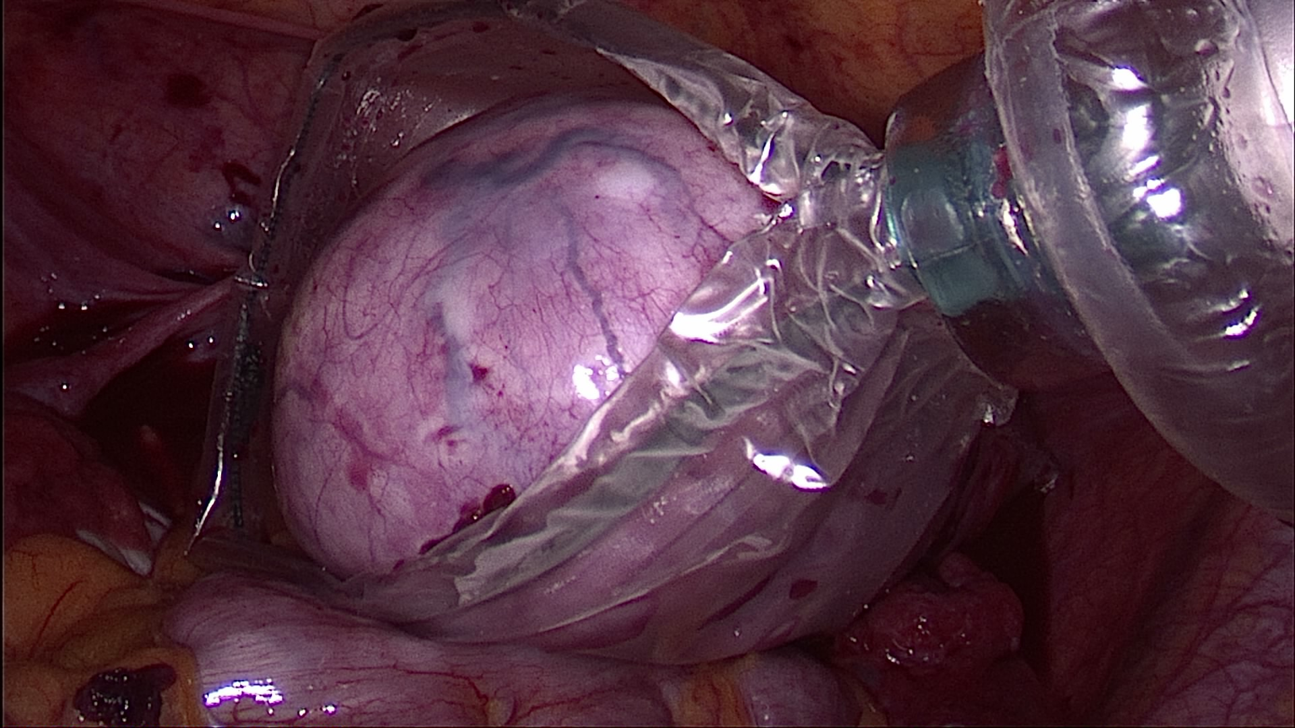
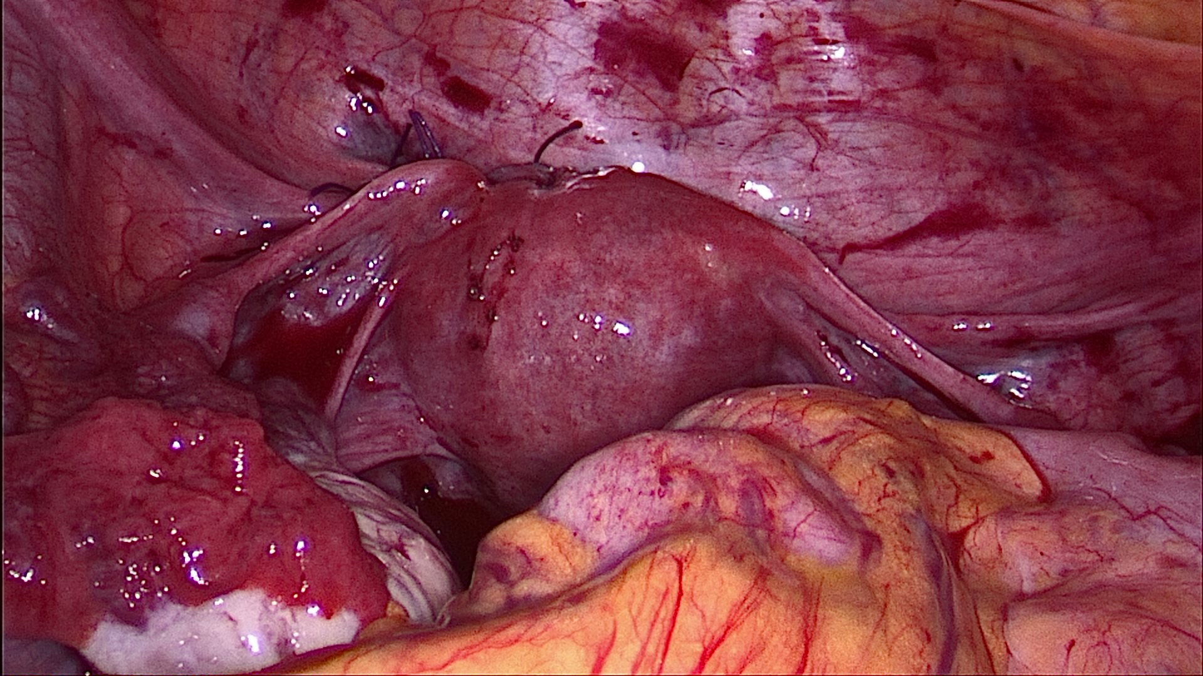
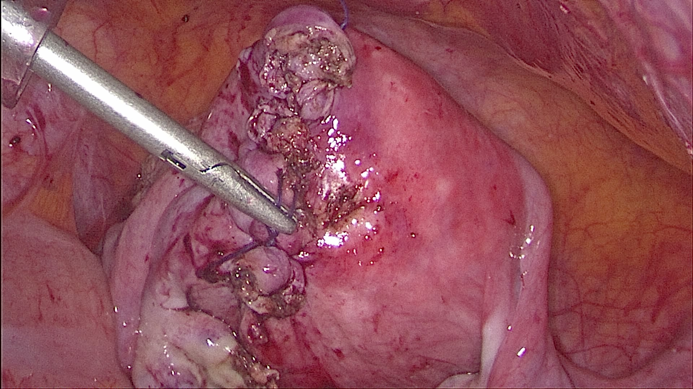
ME
1. IM myom 7 cm, nulipara 2. SS myom 8x5 cm nulipara nar. 1989

Slide 16
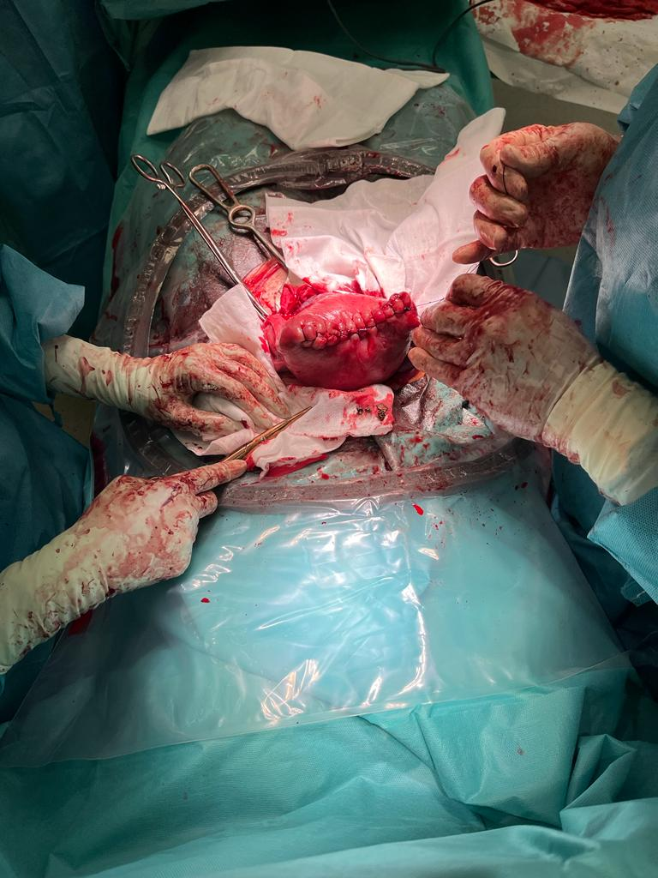
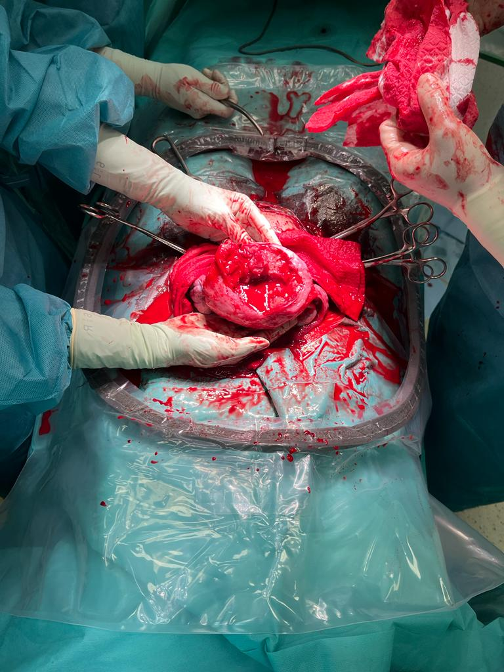
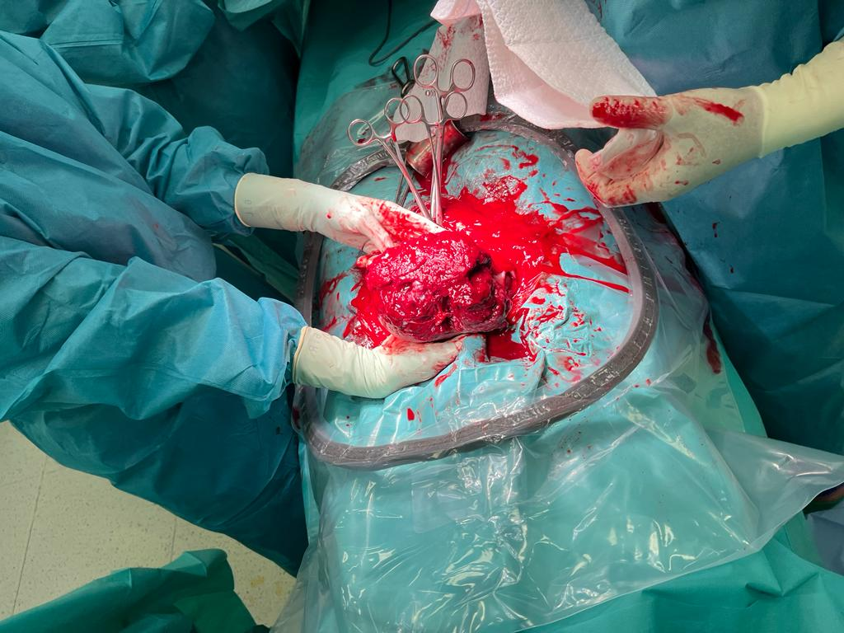
Rpt dělohy SC 1. po LSK ME 2. po HSK

Slide 17
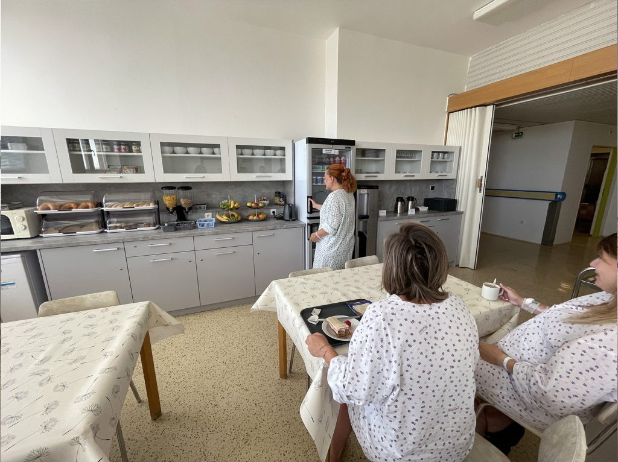
Péče po SC
Perioperační prostředí – přátelské + bezpečné
Pooperační péče, prevence TEN, infekční,
včasná vertikalizace, extrakce PMK, časná dimise
Rooming in
Rodinný pokoj
RHC
Péče o jizvu
Psychologická péče
Nutriční podpora
Laktační poradenství
Plánované gyn. kontroly
Péče OG
Možnost VBAC

Slide 18
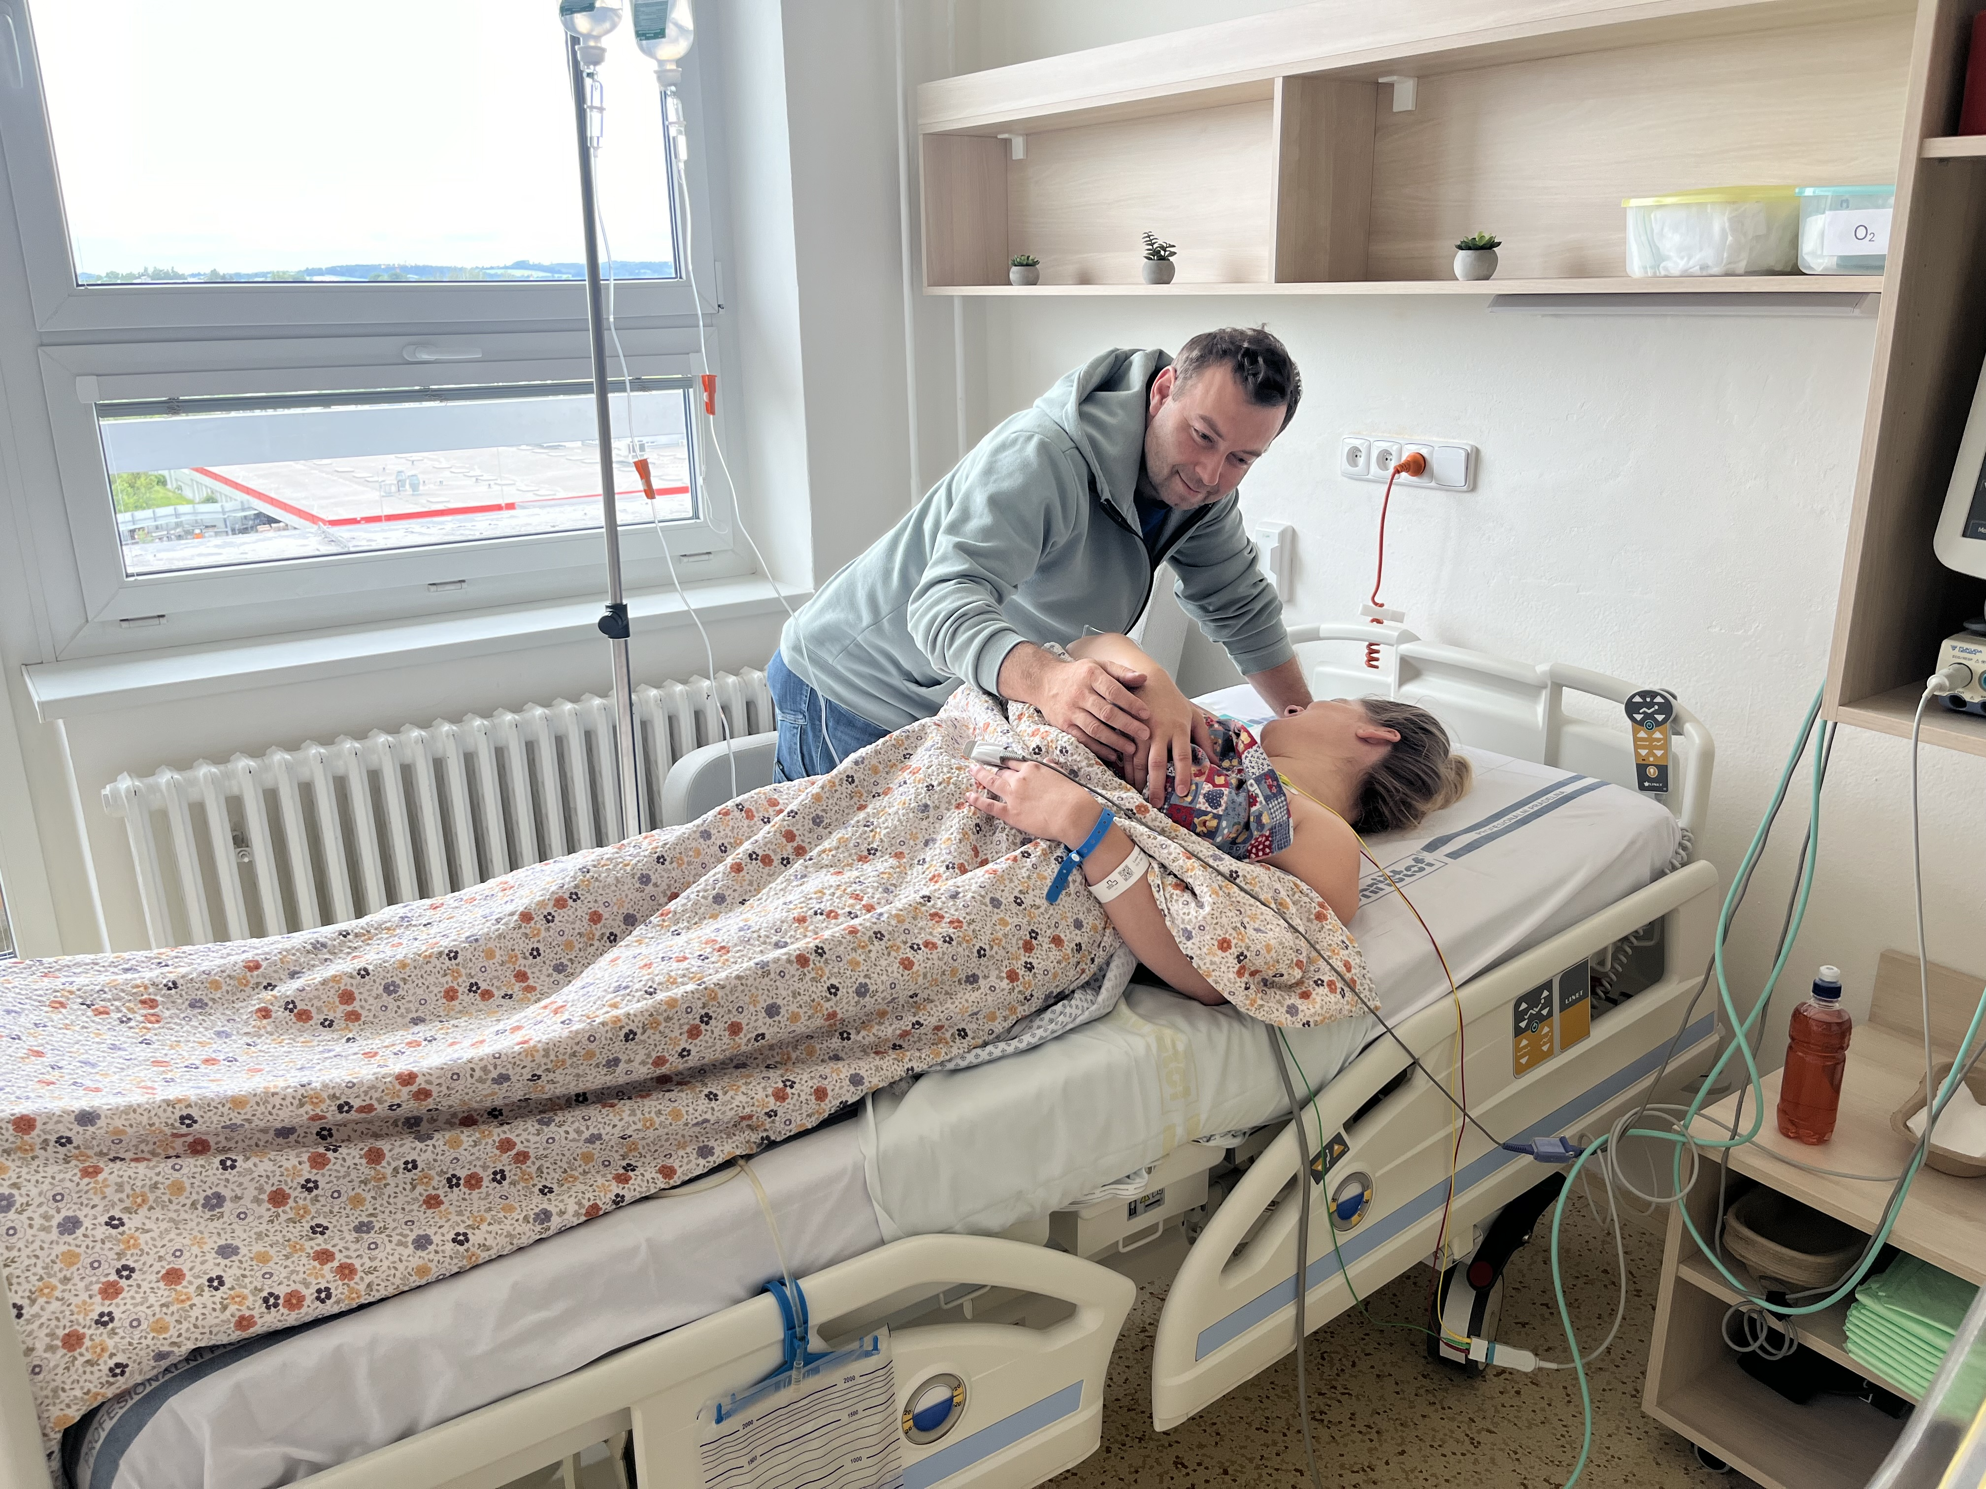
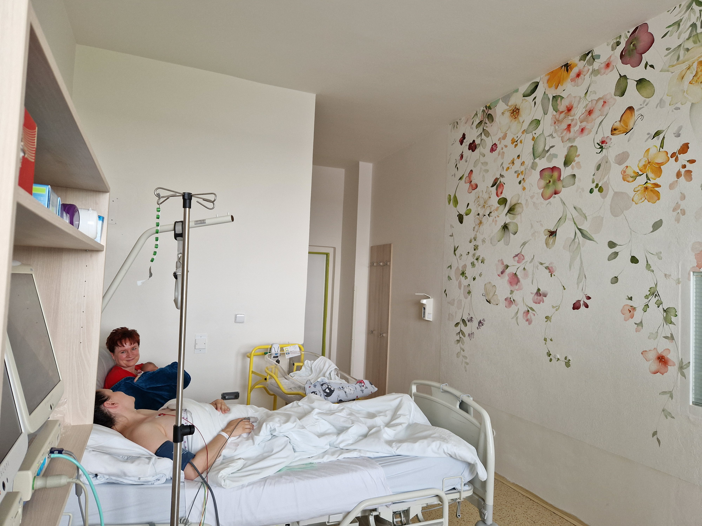
„Pooperační rodinný pokoj“

Slide 19
Pozvánka
čtvrtek 25.9.2024 Seminář prim. MUDr. Petr Kessler (Nem. Jihlava)
Hematologická péče o gravidní ženy s rizikem trombotických komplikací
Hormonální antikoncepce z pohledu hematologa
čtvrtek 7.11.2024 Konference porodních asistentek Jihlava 15.ročník (VŠPJ)
- prim. dr. P. Kaščák, dr. M. Kameníková, Mgr. D. Ondroušková, Mgr. Z. Volavá, Mgr. J Křemenová, PA R. Daňhelová, PA A. Fančovičová, PA A. Nováková, dr. V. Dvořáková, dr. Škorpíková, s. Hosová, s. Sedmíková, s. Zemanová, …

Slide 20
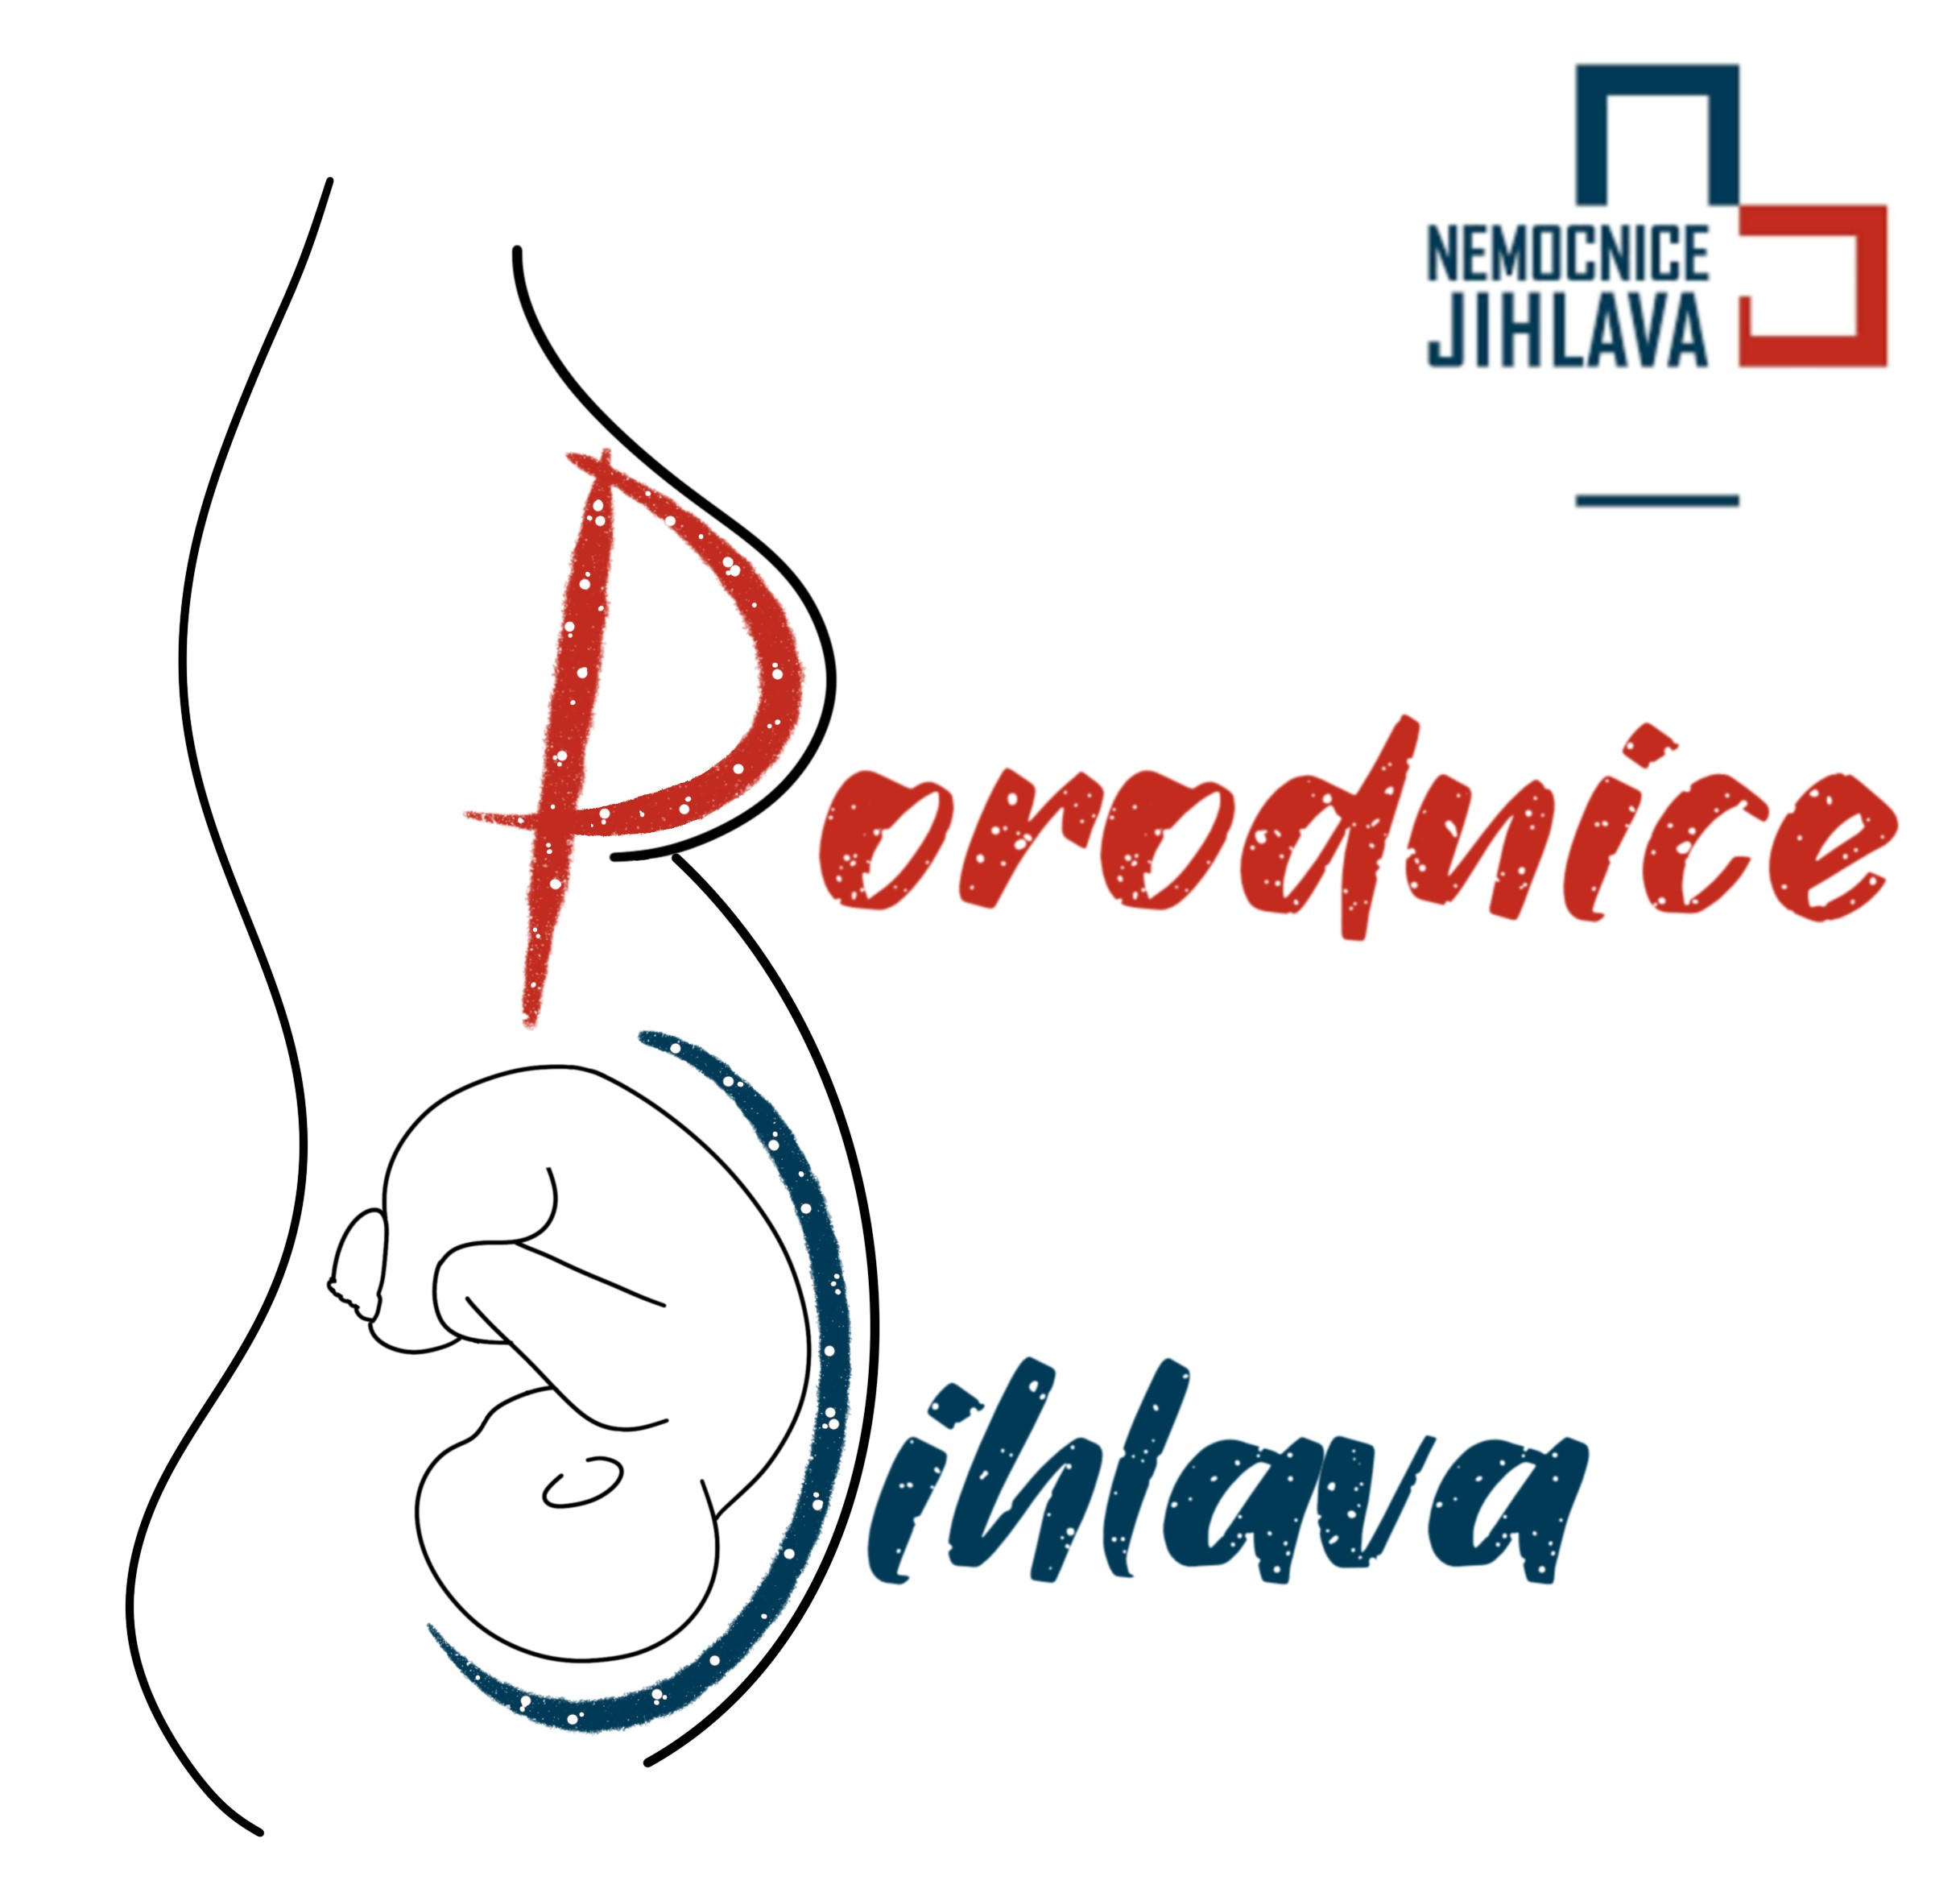
Děkuji za pozornost
herboltovap@nemji.cz

